Slide 1

Social Media Moderation

Slide 2
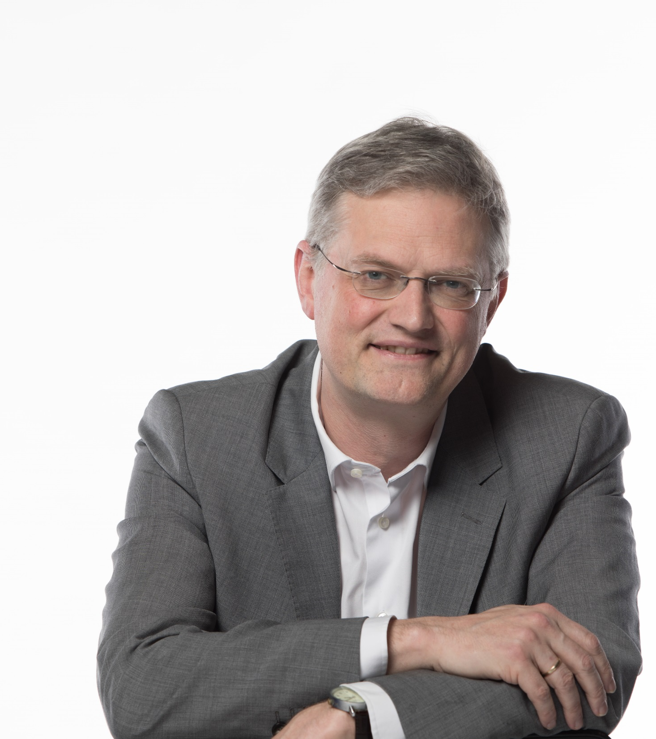
News ombudsman
Tim pauwels

Slide 3
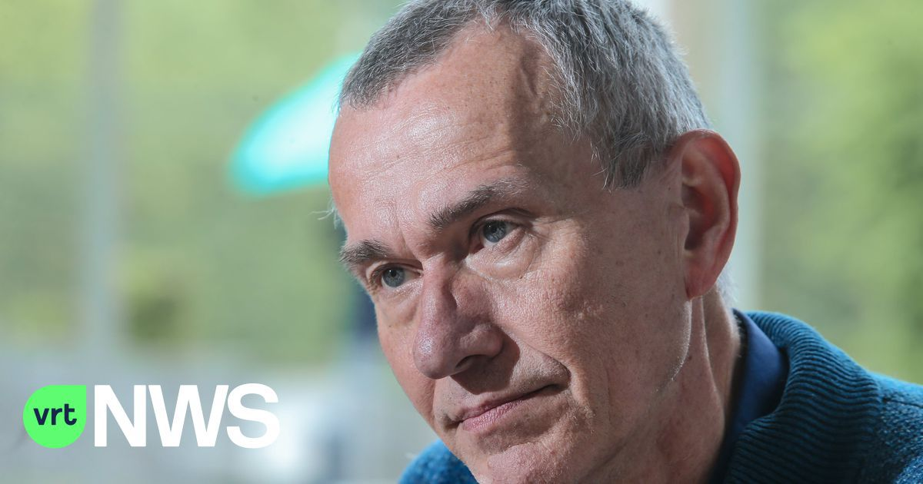
Frank Vandenbroucke
Minister of Health

Slide 4
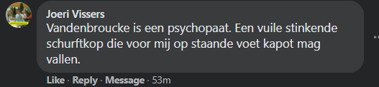
“Frank Vandenbroucke is a psychopath. A filthy stinking dumbhead who can drop dead immediately as far as I am concerned.”

Slide 5
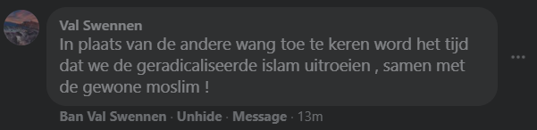
“It is about time we eradicate radical islam, together with normal Muslims.”

Slide 6
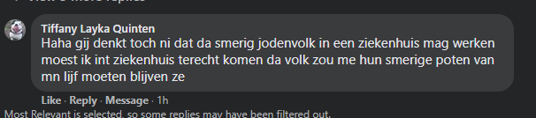
“Do you really think that this filthy Jewish people should be allowed to work in a hospital? When I would be admitted in hospital this people should not thouch my body with their filthy paws ”

Slide 7
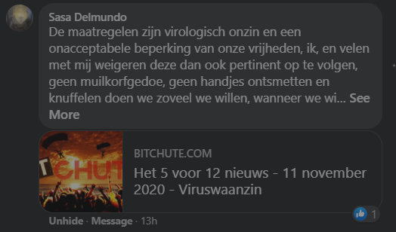
“The meausures are virological nonsense and an unacceptable limitation of our freedom, I, and many others with me refuse to follow them. No muzzling with masks, no hand disinfection and hugging we do as much as we want…”

Slide 8
Yes, this really was on our Facebookpages

Slide 9
Why moderation ?

Slide 10
Why moderation on social media?
We did moderation. But rather as a nice to have. We did not really take it at heart.
We stopped comments on our own news website because we did not find the hands and resources to organise effective moderation. But this just made Facebook the place to be.

Slide 11
It is a duty
Although we sometimes forget about it, our redaction statute actually says that we have to do it.

Slide 12
It helps our brand

Slide 13
Why moderation on social media?
A negative atmosphere damages our brand.
A positive one helps us.

Slide 14
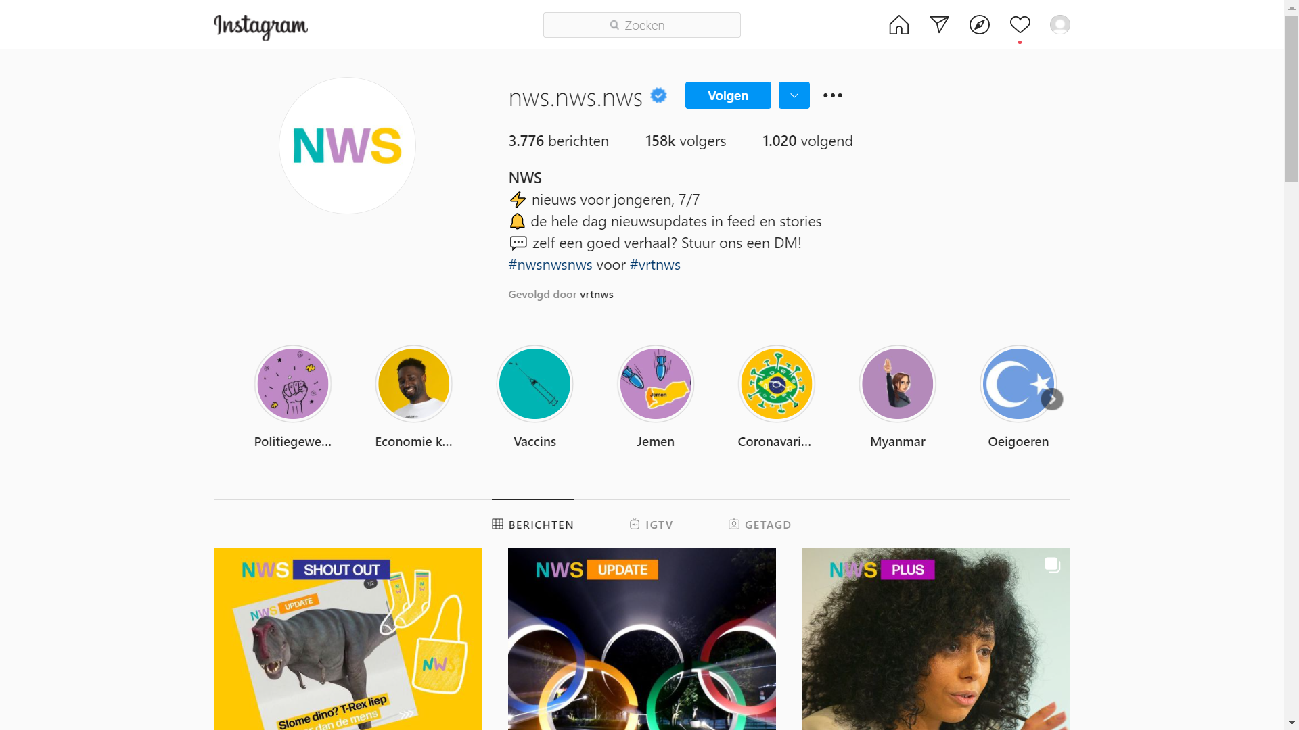

Slide 15
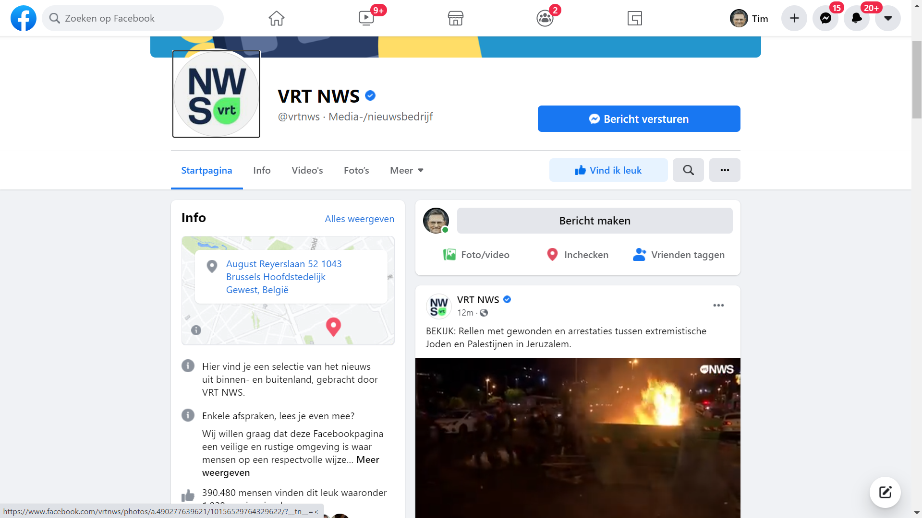

Slide 16
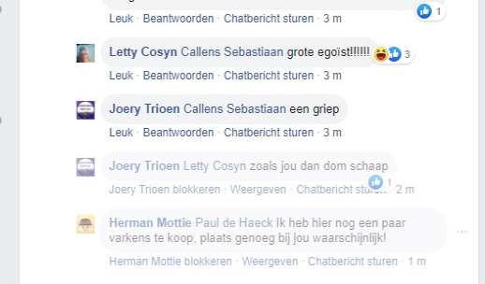
Big egoist !!!!!!
Just like you then, stupid sheep
I have a couple of sheep for sale, probably room enough at your place!

Slide 17
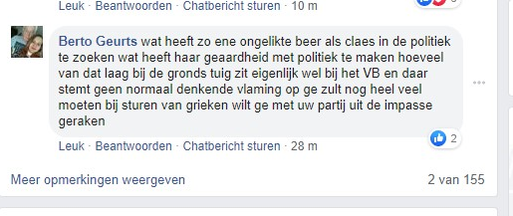
“What’s he looking for in politics, this clodhopper? How much commonplace scum they have among them at Vlaamse Belang ?”

Slide 18
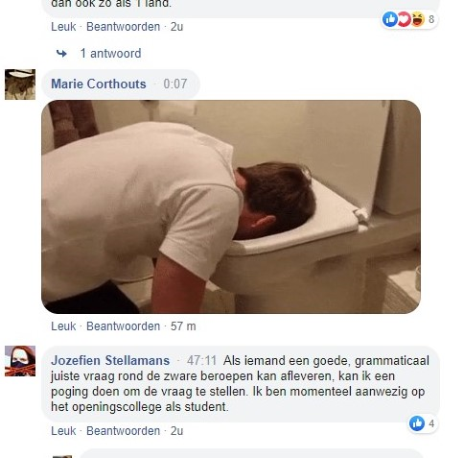

Slide 19
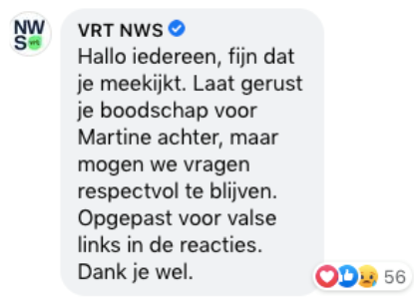
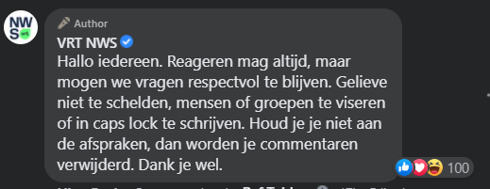
Appeals to keep polite very often get warm responses and likes
100 likes
56 likes

Slide 20
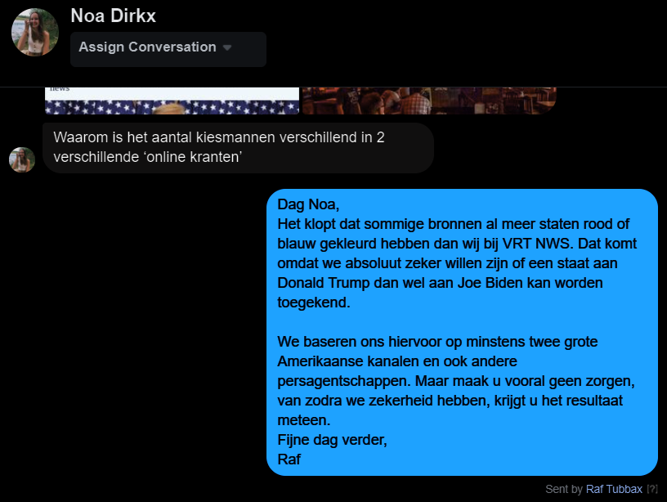
To answer helps !
We are not slower in calling states for Trump or for Biden, only more prudent.

Slide 21
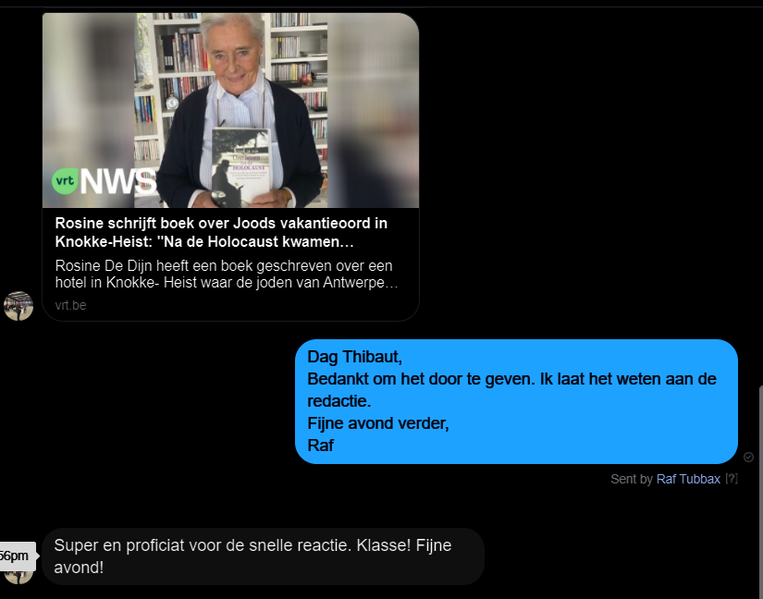
- Thank you for passing this information, we ‘ll inform the redaction.
- Super, congrats on the swift reaction.

Slide 22
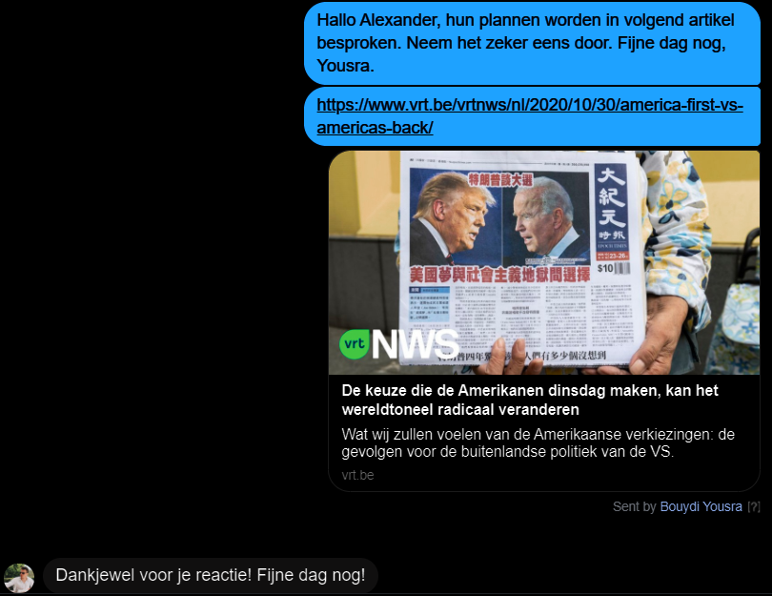
- Hey Alexander, we discuss the plans of both canditates in this article.
- Thank you for your reaction, have a nice day!

Slide 23
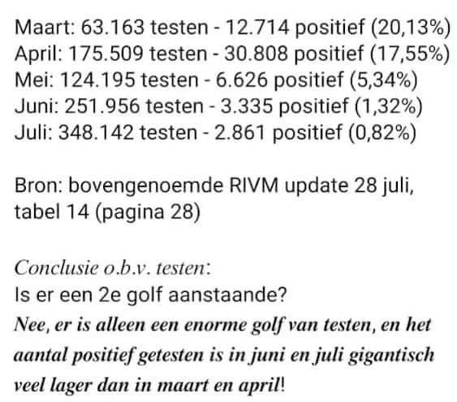
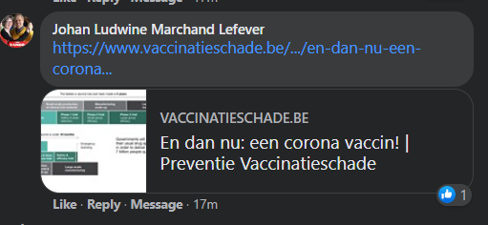
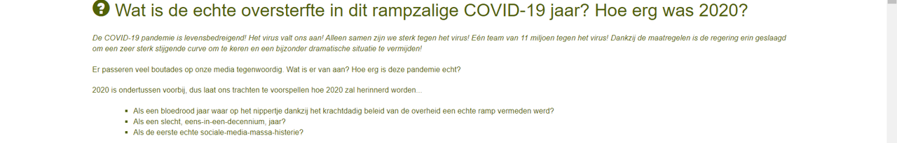
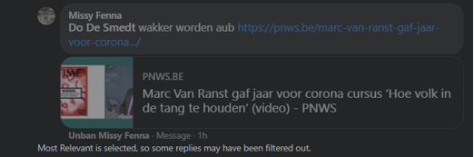
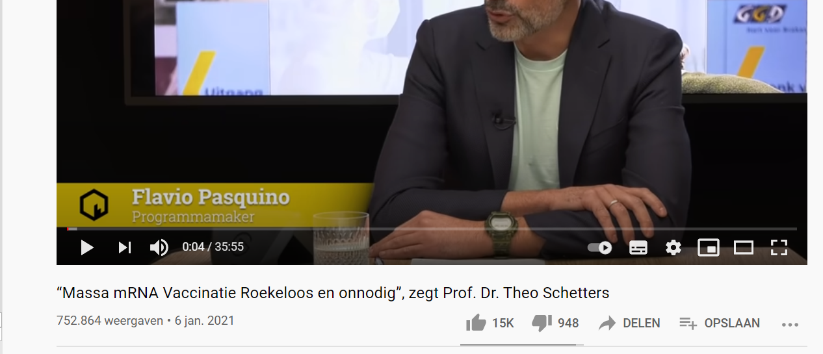
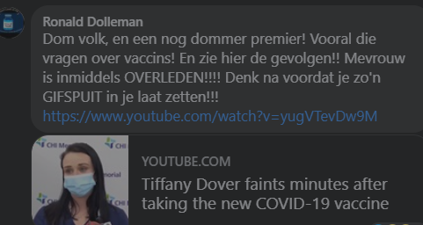
There is no second wave, just a bit more testing.
This woman was killed by a vaccine
Vaccines are dangerous

Slide 24
Why Moderation?
It is a duty
It helps our brand
PSM has to set an example
Community Building

Slide 25
the experiment

Slide 26
The Experiment
3 FTE
New user rules
Testing of the Textgain app
Replying to questions
Moderation !

Slide 27
The Experiment itself
1. Intensive Live moderation on Facebook VRT NWS
3 FTE
From 8.30am to 11pm (week days) & 11am to 7.30pm (weekend),
7/7
2. Extensively on TerZake Facebook
- Only the app!
3. No moderation on Facebookpages of De Afspraak, 7Dag, Radio etc.

Slide 28
The User Rules

Slide 29
The new user rules
“No claims we cannot verify”

Slide 30
Textgain app

Slide 31
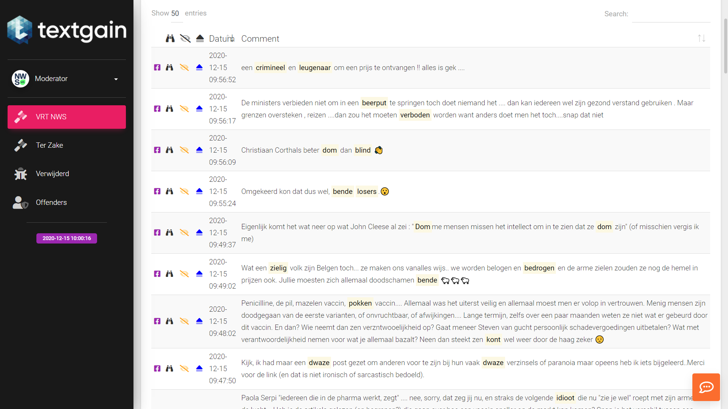

Slide 33
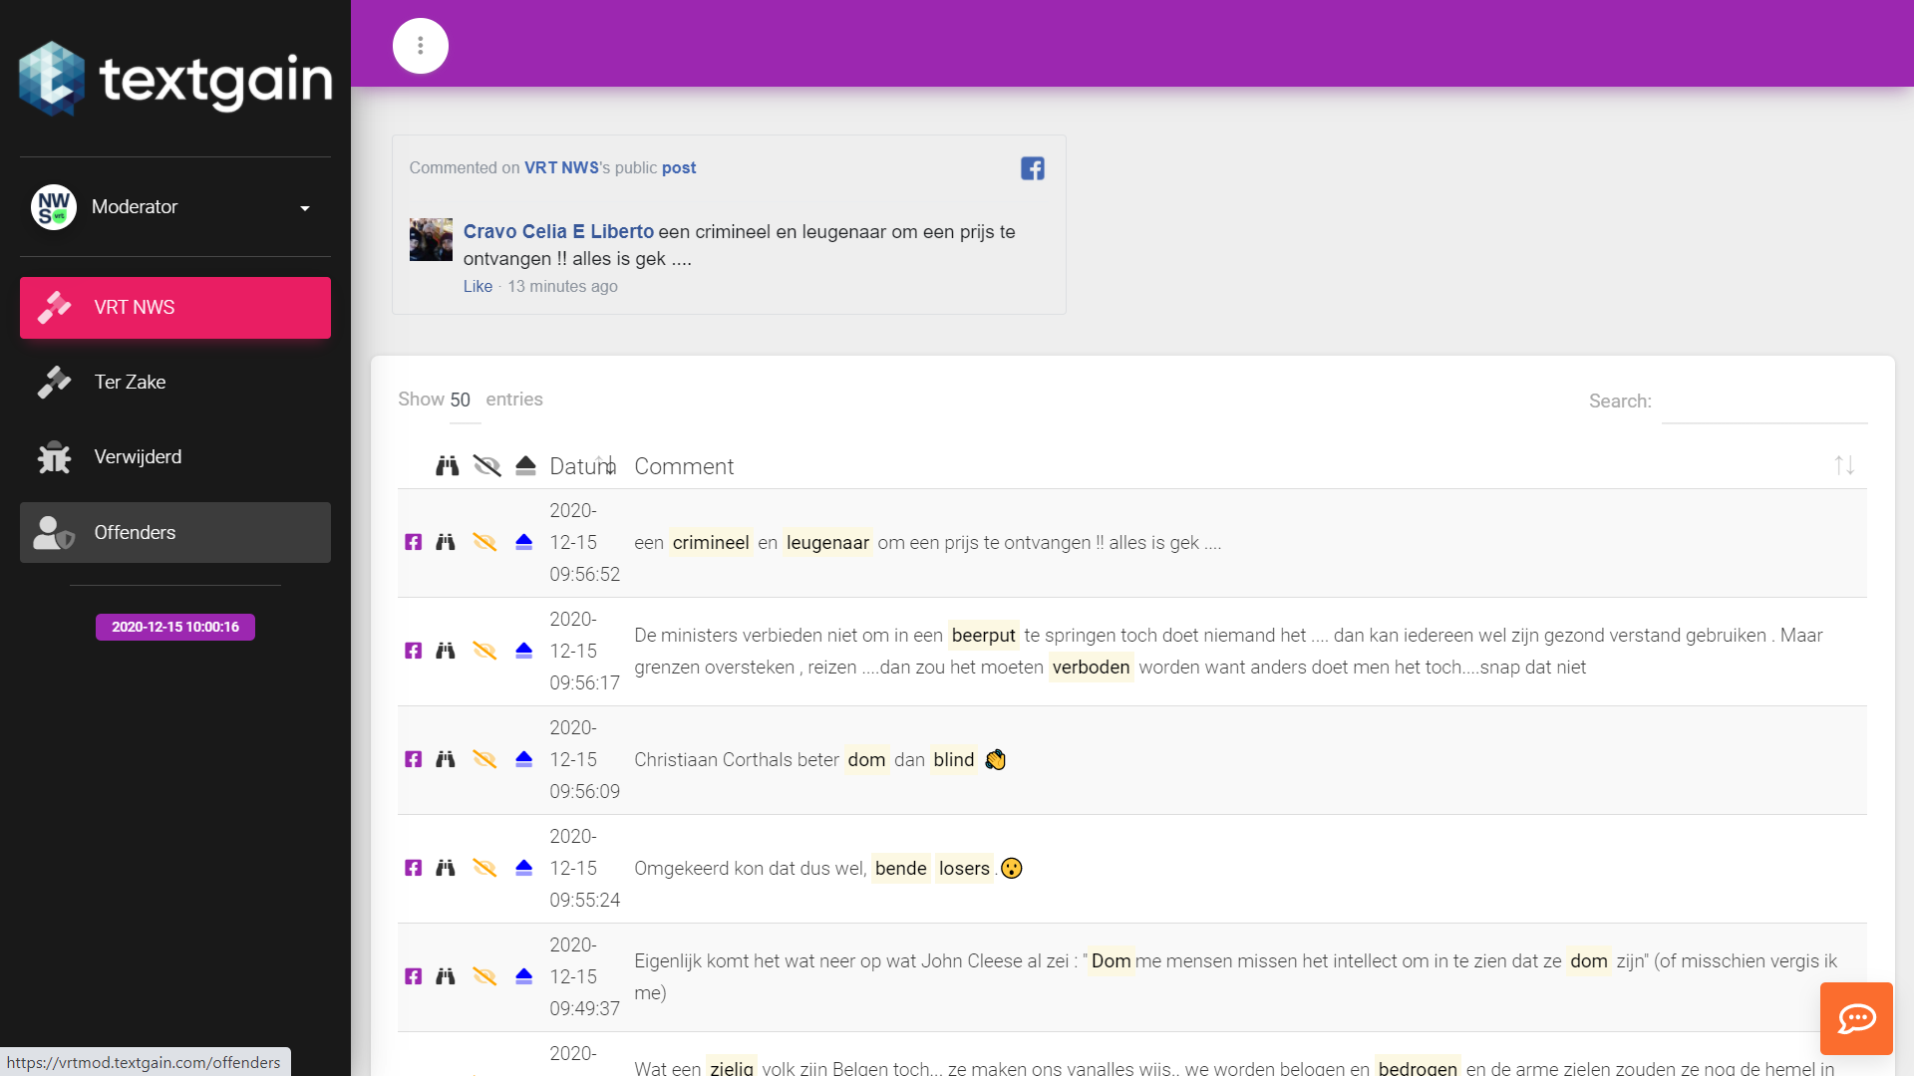

Slide 35
De Textgain app
Does not replace human moderation.
  live moderation often really necessary and better.
  Human judgement still needed.
  A.I. not “catching” everything.
  It aids and allows low intensive moderation.
  Also good for “follow up moderation” afterwards.

Slide 36
What did we learn?
Just showing you are present, has already positive impact.
Be a person, not an authority. (“Have a nice day, Thomas”)
Hiding rather than deleting
Service is welcomed (“Here you find the link”)
Remove the rotten apples, save the basket.
Close the comment section on Facebook. (New!)

Slide 37

Moderation op Twitter

Slide 38
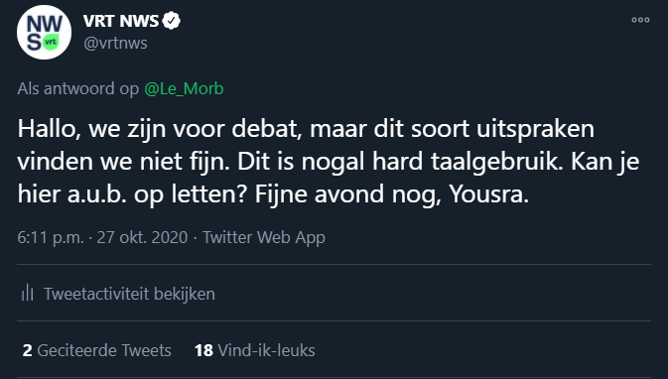
What did we learn?
We don’t like this kind of speech. It is rather harsh. Can you please take that into consideration. Have a nice evening, Yousra.
Twitter ⇒ we can block reactions but Twitter stays a difficult medium to moderate.
Showing your presence in reactions = incites debate, can escalate quickly
Direct messages to rectify things

Slide 39
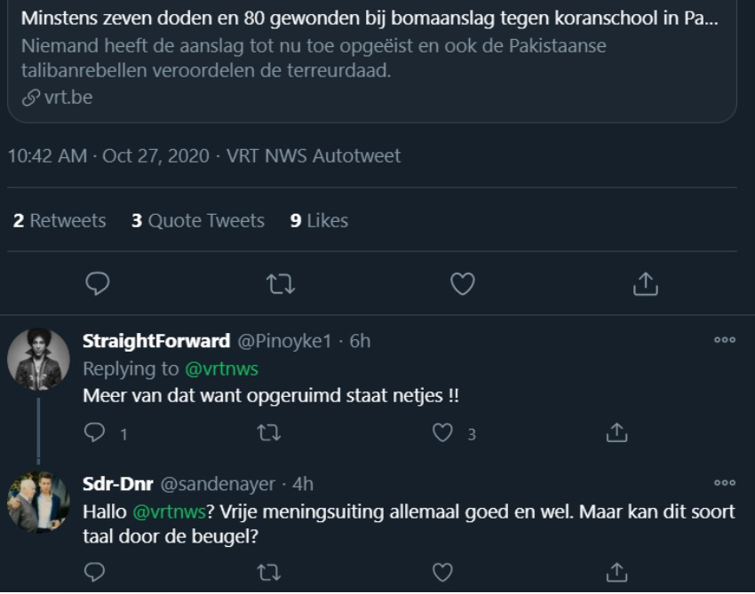
Moderation on Twitter is partially expected by users on our own twitter “channels”
“Hello @vrtnws? Freedom of expression is great, but can this kind of language pass?”

Slide 40
Opportunities

Slide 41
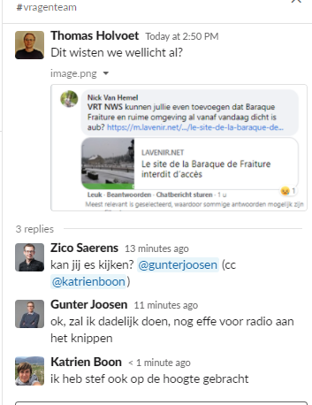
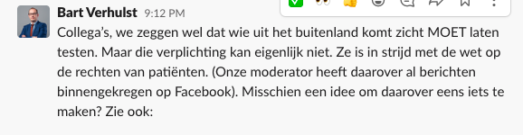
A well known site in Belgium was closed for covid safety reasons because too many people wanted to have a hike there. It is our moderators that signalled that to the redaction.
Moderation is making News possible
- Users pointed out that an obligation to take a coranatest was actually against Belgian law. Citizens did have the option to go into quarantaine. The redaction asked questions to the government about this.

Slide 42
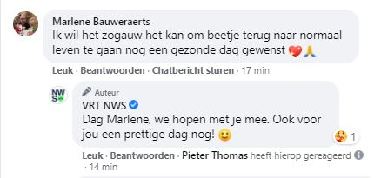
Community Building
- I long so much for a normal life. Wish you a healthy day.
- Same hope here, Marlene. Have a nice day yourself.
Engagement
Appropriate and measured

Slide 43
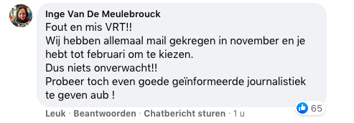
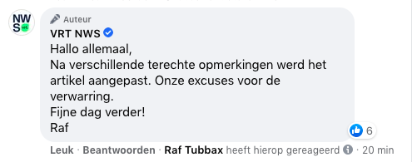
Correct errors
Hi everyone,
Many people pointed this out and they were right. Our apologies. We updated the article. Have a nice day, Raf
Disclaimer put more than 40 times.
Disclaimer liked by Argenta België.

Slide 44
Impact moderation ?

Slide 45
Impact moderation ?
VRT NWS on Facebook became a less toxic environment

Slide 46
Impact: numbers
30.000 à 40.000 messages hidden every month.
50 people blocked every month. (They can file a complaint with the news ombudsman)

Slide 47
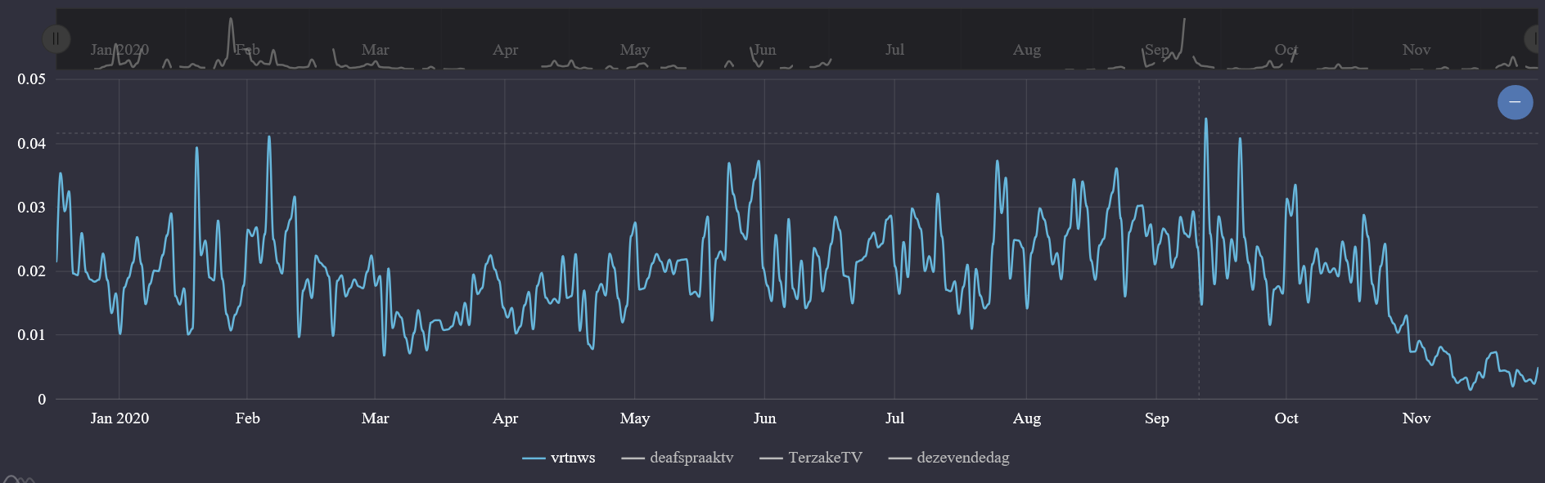
VRT NWS // Textgain-measuring (jan - dec)

Slide 48
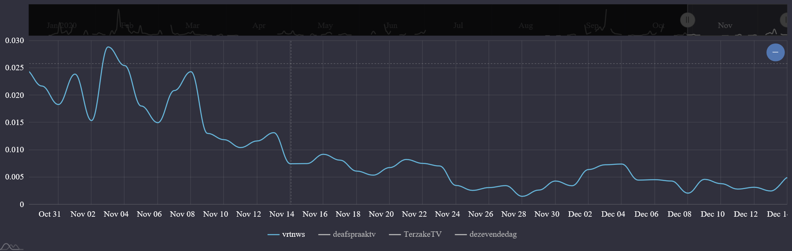
VRT NWS // Textgain-measuring (nov - dec)

Slide 49
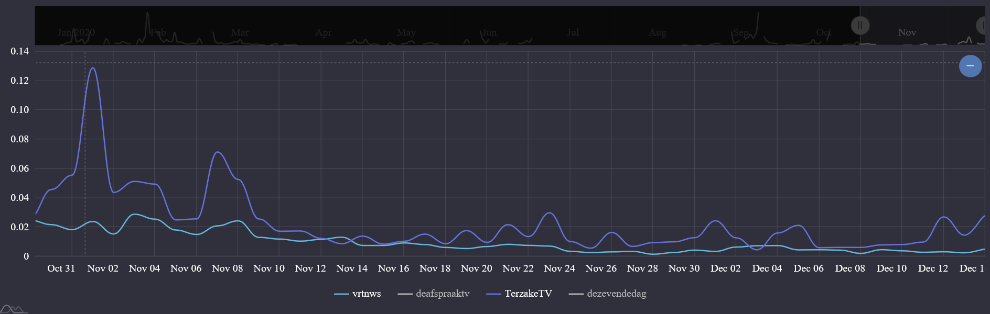
VRT NWS vs. Terzake // Textgain-measuring

Slide 50
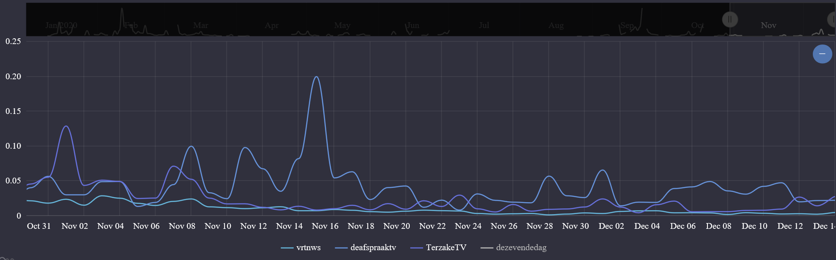
Textgain-measuring overview (sept - dec)

Slide 51
Conclusions

Slide 52
Conclusions :
What ?
It is a duty.
It is an opportunity for our brand
We hope it will result in community building in the long run.
It connects us with the pulse of the public.
Helps us to deliver better content, tips on news.
  errors, trends, question, complaints

Slide 53
Conclusions
How ?
It will never be perfect
A.I. is an interesting addition but can’t be a full replacement for human moderation .
Social Media Moderation is a workload.

Slide 54
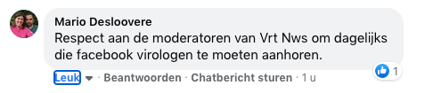
Respect for the moderators who have to listen to this nonsense from Facebook-educated “virologists”.

Slide 55
The Future?

Slide 56
Social media are not a one way channel, they are SOCIAL

Slide 57
Interaction is a fourth medium

Slide 58
Interaction redaction

Slide 59
Thank you for your attention
Let us interact. ☺

Slide 62

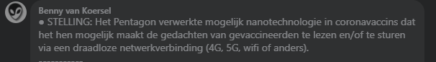


Slide 63
Continued due to success

Slide 64
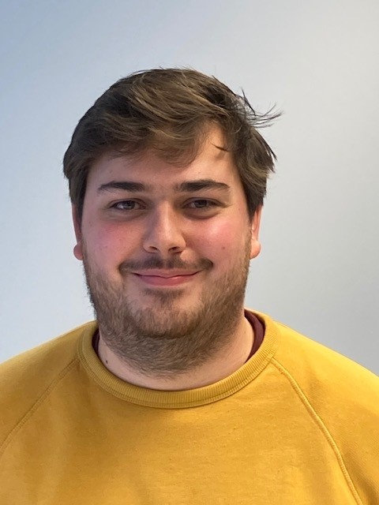
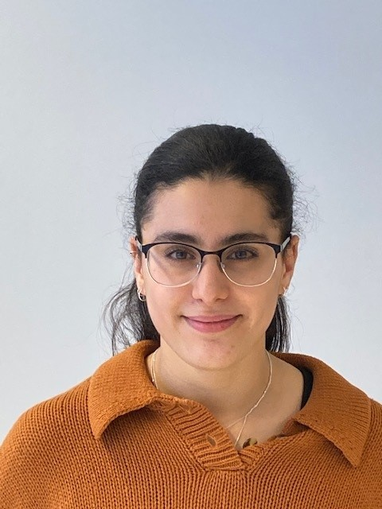
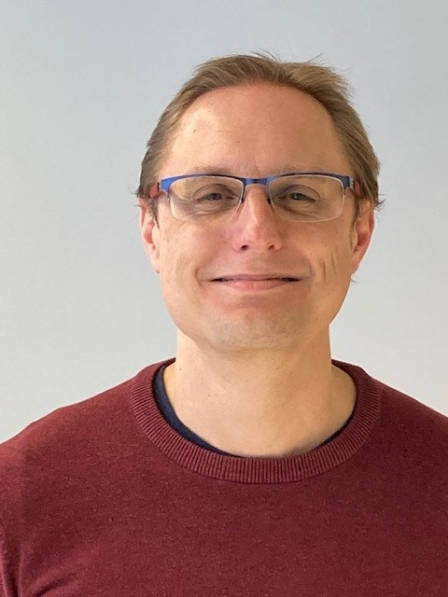
Raf.tubbax@vrt.be Youssra.bouydiri@vrt.be Thomas.holvoet@vrt.be

Slide 65
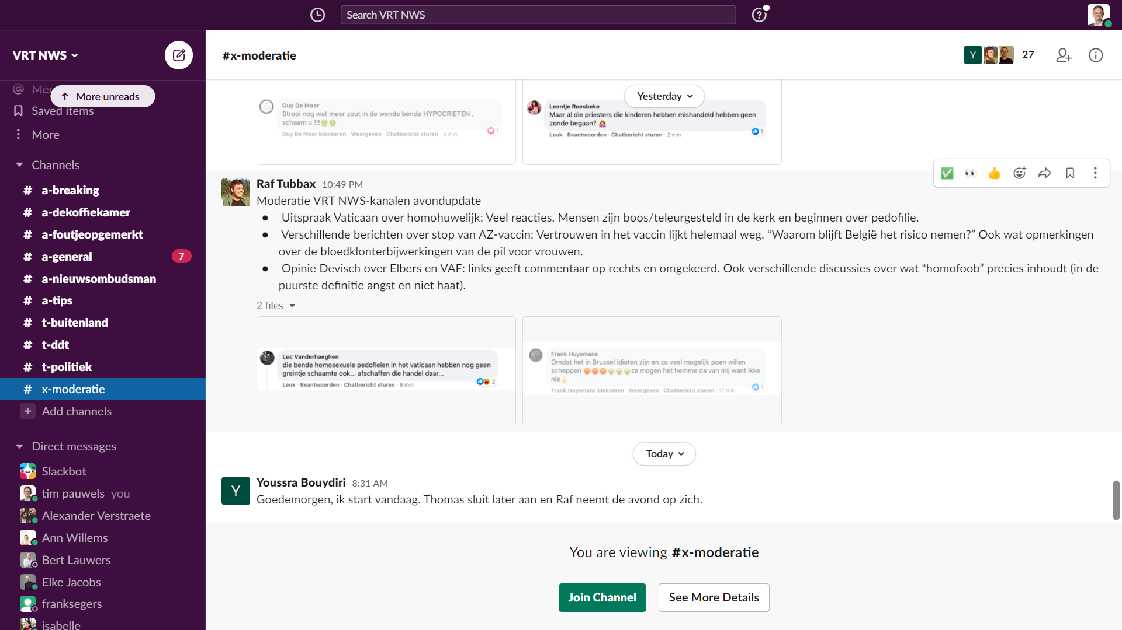

Slide 66
Be careful on your personal social media https://www.vrt.be/nl/over-de-vrt/beleid/beroepsethiek/10-geboden-voor-sociale-media/

Slide 67


